Slide 1
Structured Programming
Nahidul Islam
Lecturer, Dept. of CSE
DCC, Dhaka.

Slide 2
RECURSION
Recursion is a process by which a function calls itself repeatedly, until some specified condition has been satisfied.

Slide 3
Factorial of an integer
#include <stdio.h>
int fact (int);
int main() 4.{
int n,f;
printf("Enter the number whose factorial you want to calculate?");
scanf("%d",&n);
f = fact(n);
printf("factorial = %d",f); 0.}
1.int fact(int n) 2.{
Output:
Enter the number whose factorial you want to calculate?5 factorial = 120
if (n==0)
return 0;
else if ( n == 1)
return 1;
else
return n*fact(n-1);
9.}
3

Slide 4
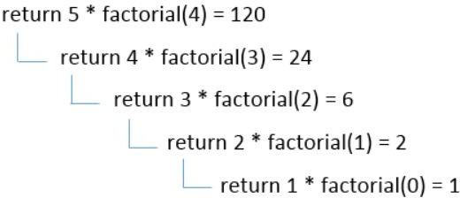
Factorial of an integer
1*2*3*4*5 = 120
4

Slide 5
#include<stdio.h>
int fibonacci(int);
void main ()
{
int n,f;
printf("Enter the value of n?");
scanf("%d",&n);
f = fibonacci(n);
printf(“Output is : %d",f);
10.}
int fibonacci (int n)
{
Find the nth term of the Fibonacci series
if (n==0)
{
return 0;
16. }
else if (n == 1)
{
return 1;
20. }
else
{
return fibonacci(n-1)+fibonacci(n-2);
24. }
25.}
Enter the value of n? 12
Output is: 144
5

Slide 6
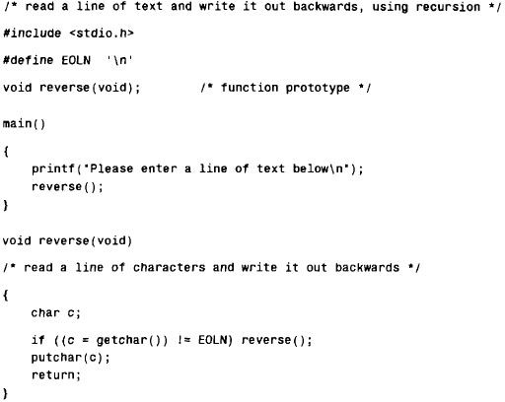

Slide 7
Output:
Now is the time for all good men to come to the aid of their country!
!yrtnuoc r i e h t fo dia eht ot emoc ot nem doog lla rof emit eht si woN

Slide 8
The Towers of Hanoi :
The Towers of Hanoi is a well-known children's game, played with three poles and a number of different-sized disks. Each disk has a hole in the center, allowing it to be stacked around any of the poles. Initially, the disks are stacked on the leftmost pole in the order of decreasing size, i.e., the largest on the bottom and the smallest on the top.
The object of the game is to transfer the disks from the leftmost pole to the rightmost pole, without ever placing a larger disk on top of a smaller disk. Only one disk may be moved at a time, and each disk must always be placed around one of the poles.

Slide 9
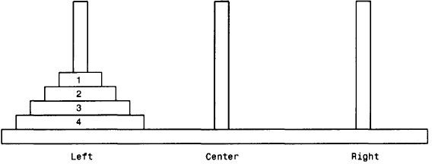

Slide 10
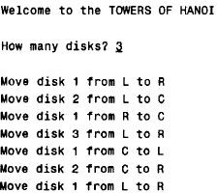
For the case where n =3, the following output is obtained

Slide 11
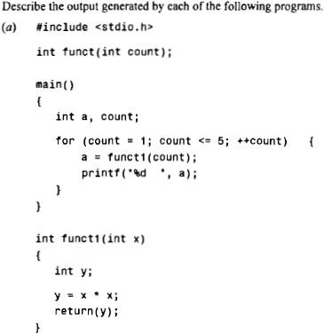
Find output

Slide 12
Find output
Output of previous program: 1 4 9 16 25

Slide 13
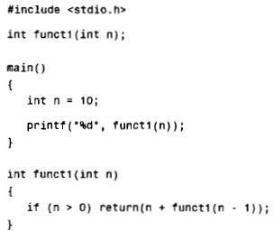
Find output

Slide 14
Find output
Output of previous program : 55

Slide 15
Global and local variables
A local variable is a variable that is declared inside a function. A global variable is a variable that is declared outside all functions.
A local variable can only be used in the function where it is declared. A global variable can be used in all functions.

Slide 16
Global and local variables
void function1(){
int x=10;//local variable 3.}
int value=20;//global variable
void function1(){
int x=10;//local variable 4.}

Slide 17
1.#include<stdio.h>
// Global variables
int a;
int b;
int Add()
{
return a + b;
8. }
int Mul()
{
int c=10; //Local Variable
int d=20; ////Local Variable
return c*d;
}
void main()
{
int Ans1, Ans2, c=30;// Local variable
a = 50;
b = 70;
Ans1 = Add(); Ans2= Mul();
printf("The addition result is: %d\n",Ans1); printf("The Multiplication result is: %d\n",Ans2); printf("%d\n", c);
5. }
Output:
The addition result is: 120
The Multiplication result is: 200 30
17.
18.
19.
20.
21.
22.
23.
24.
17

Slide 18
Thank You
18

